Slide 1

Secure Your Digital Life: Online Privacy Strategies
Course Title: Technical Writing and Presentation Skill Development (Sessional)
Course Code: CSE 408
Presented by:
Ahla Mong Marma(1902038) Md. Mehedi Hasan (1902044)
Abubakar Saidu(1902077) Md. Moshiur Rahman(1902060)

Slide 2

Outline
Introduction
Objective
Motivation
Strategies
Conclusion

Slide 3
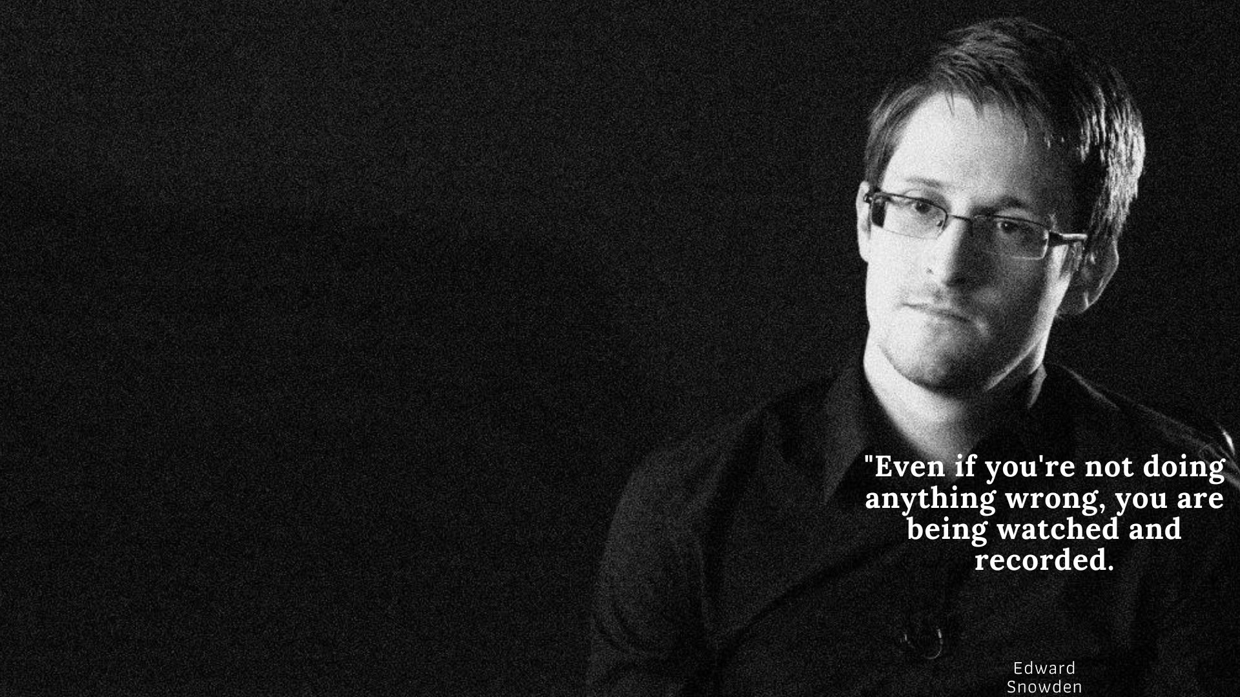
Introduction
Cyber Security
Digital life
Data Breaches and Cyber Attacks
Needs for protecting personal information online

Slide 4
Objective
Importance of protection
Risks and threats
Safeguarding strategies
Staying up-to-date

Slide 5
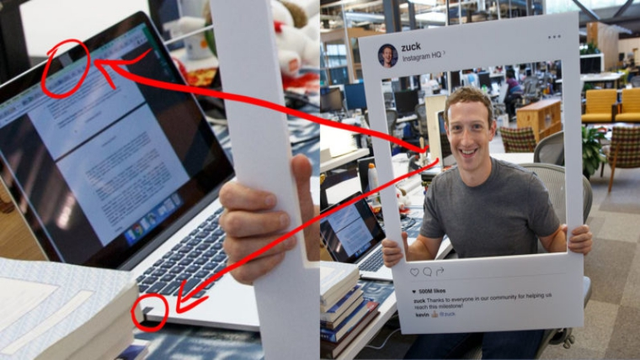
Motivation
Protect your personal information
Maintain control over your digital identity
Keep your confidential data secure
Comply with legal and regulatory requirements
Contribute to a safer and more secure digital world

Slide 6
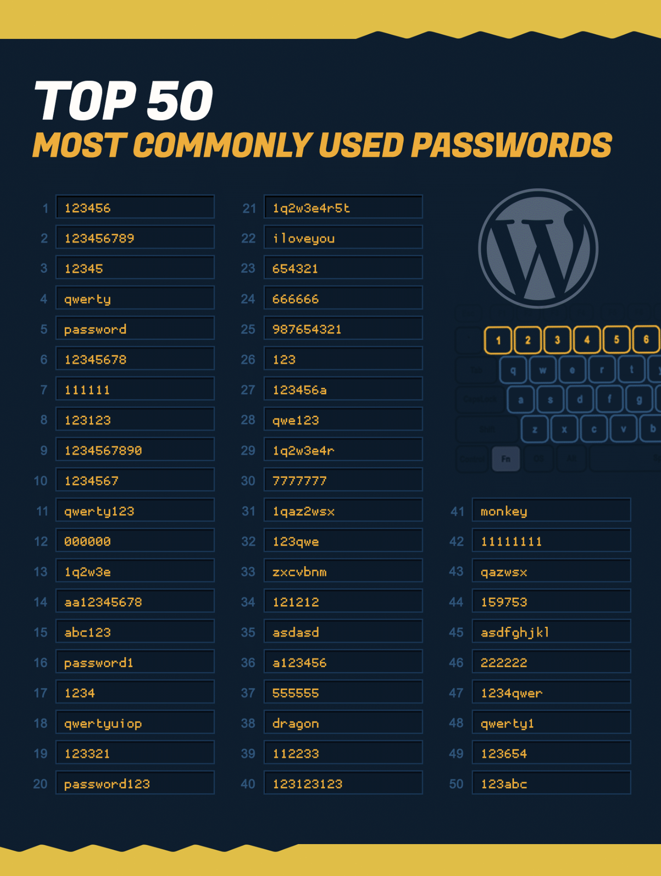

Strategies
Strong passwords and password management techniques
Importance of using strong passwords
Tips for creating strong passwords
Password manager tools and their benefits

Slide 7
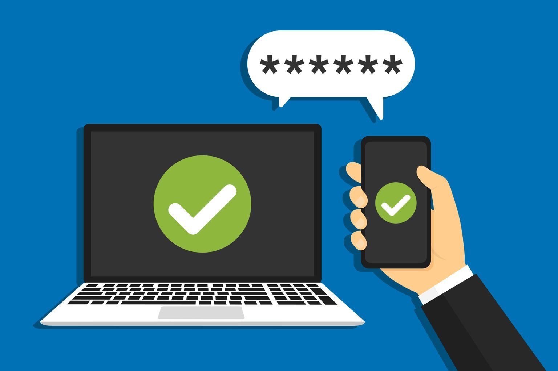
Strategies
Two-factor authentication and its importance
How two-factor authentication works
Benefits of using two-factor authentication
Popular two-factor authentication methods

Slide 8

Strategies
Don't overshare on social media
Importance of checking your privacy settings
Risks of posting too many personal details online
Importance of being cautious when sharing personal information
Types of personal information to be cautious with (location, hometown, birthday, etc.)

Slide 9
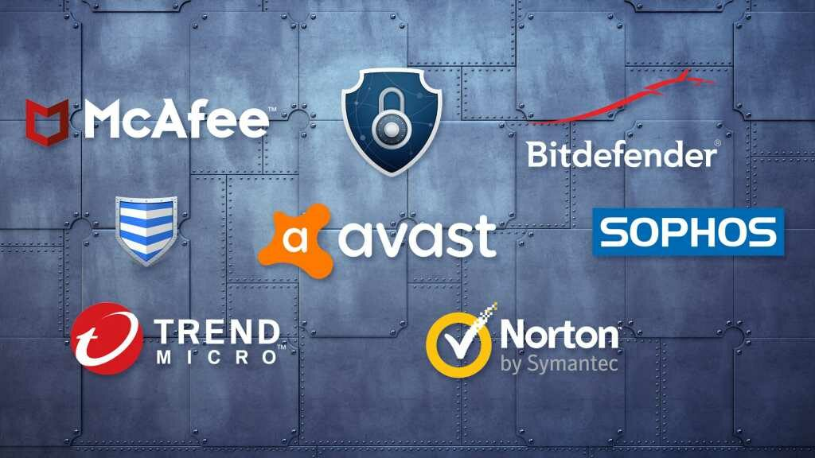
Strategies
Using antivirus and antimalware software to protect against malware and viruses
Importance of antivirus and antimalware software
Types of antivirus and antimalware software
Best practices for antivirus and antimalware protection.

Slide 10
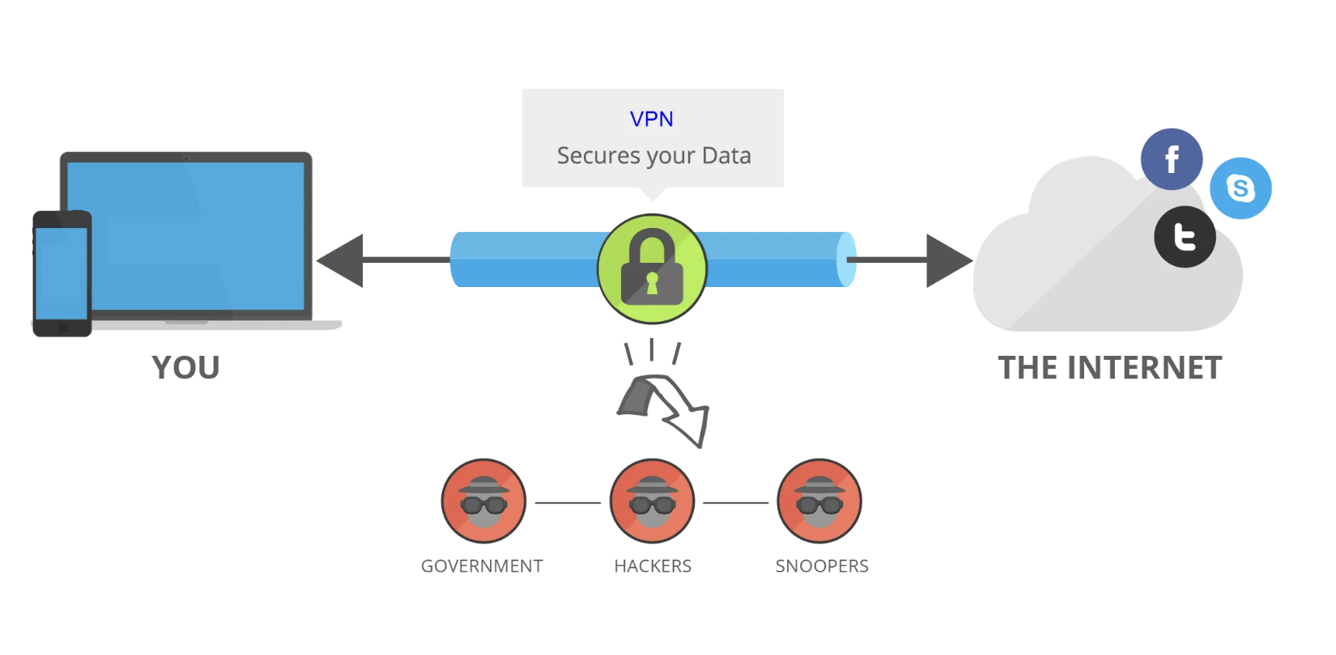
Strategies
Using virtual private networks (VPNs) to protect your internet connection
VPN and its working
Benefits of using a VPN
Types of VPNs and how to choose one

Slide 11
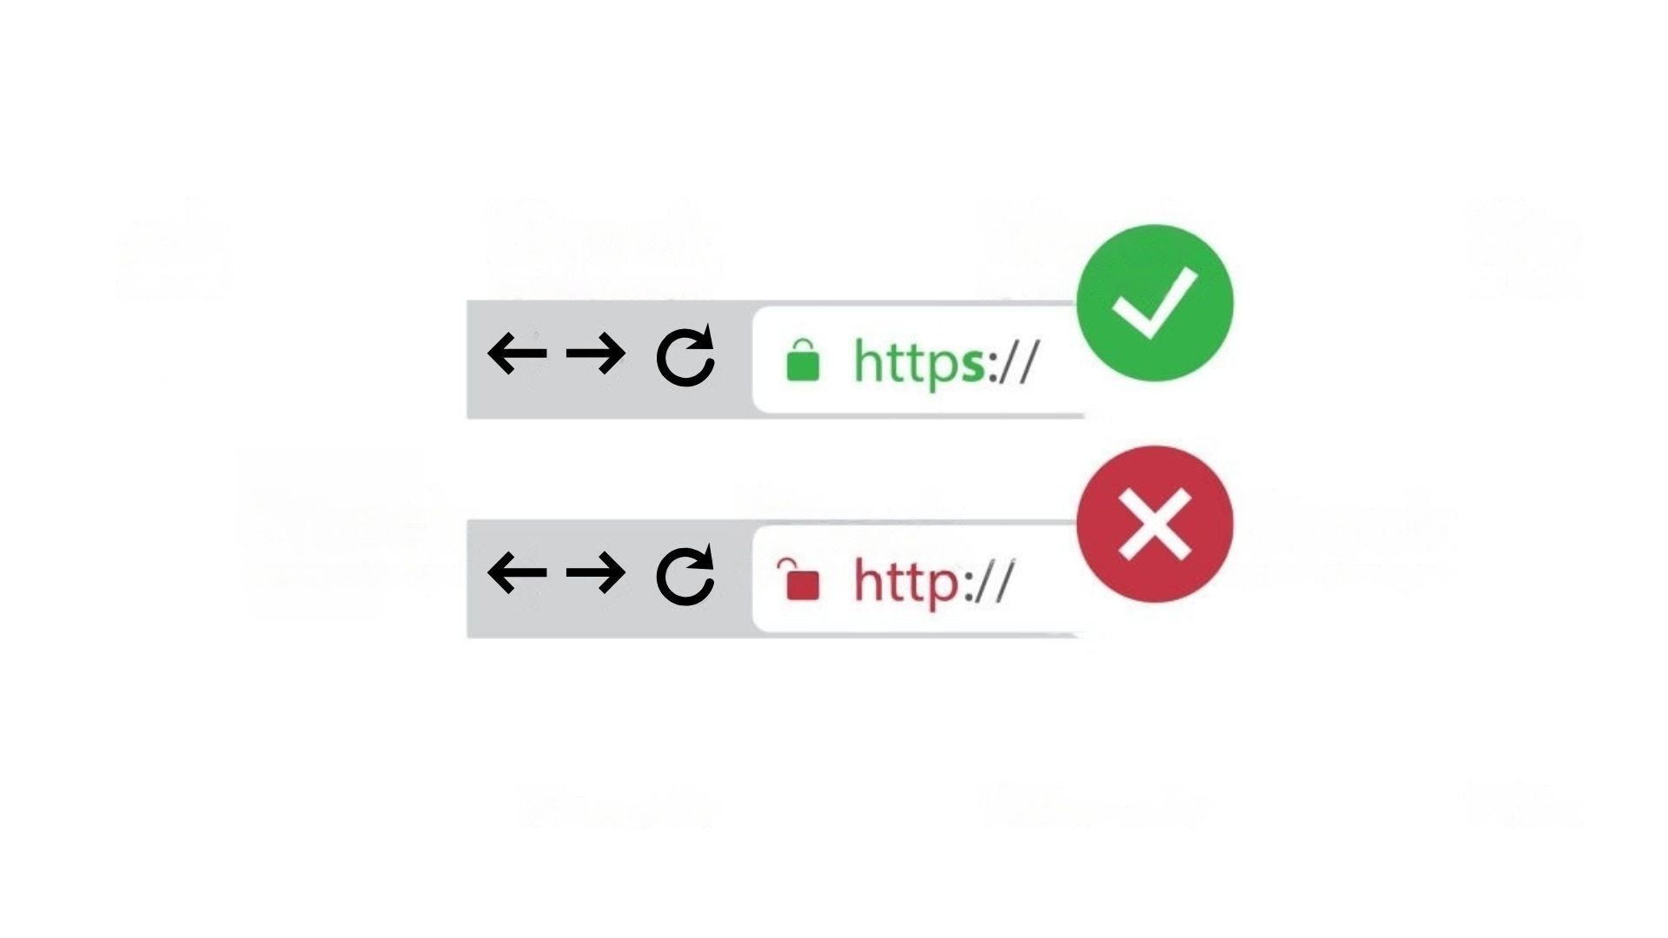
Strategies
Safe browsing practices and the use of secure websites
Importance of safe browsing practices
Tips for safe browsing
HTTPS and SSL certificates

Slide 12
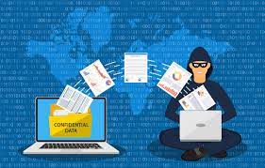
Strategies
Avoiding phishing scams and other social engineering attacks
What is phishing and how it works
How to identify phishing scams
Tips for avoiding social engineering attacks

Slide 13
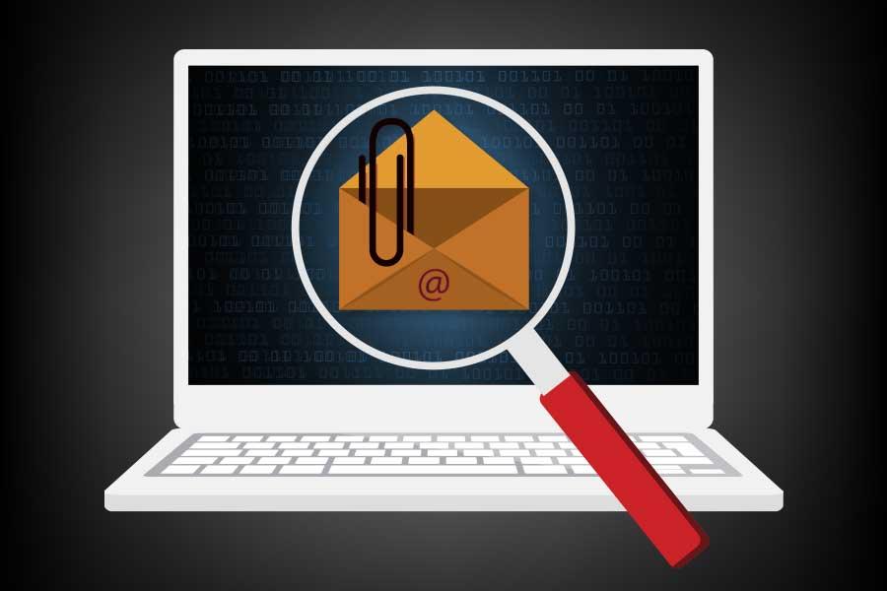
Strategies
Being cautious with email attachments and downloads
Risks of email attachments and downloads
Tips for avoiding malicious attachments and downloads
Best practices for email security

Slide 14

Conclusion
Stay informed, stay secure
Security is everyone's responsibility
Trust begins with privacy
Prevention beats regret

Slide 15
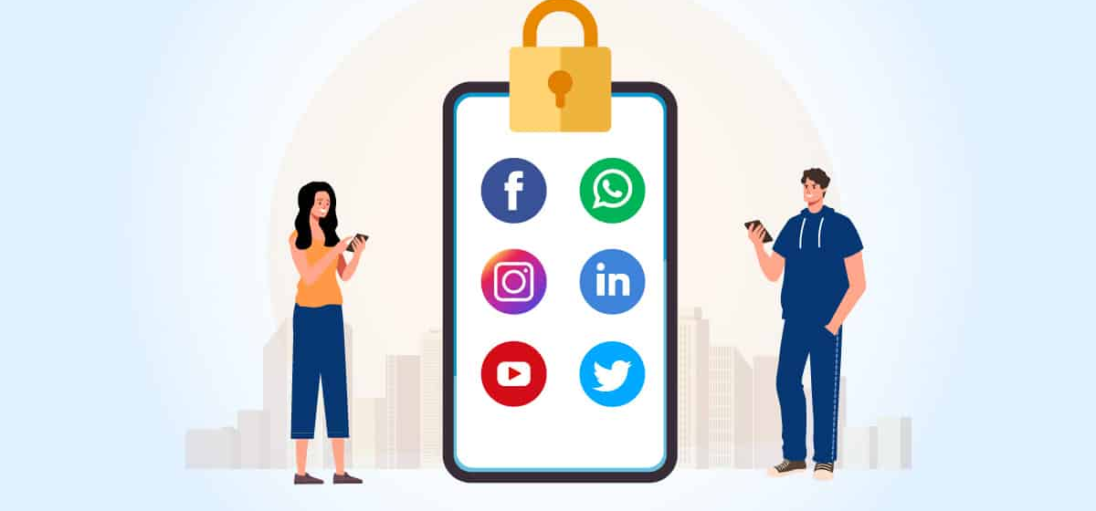
Thank You For Your Attention
Inquiries are strongly encouraged.

